Slide 1













Slide 2

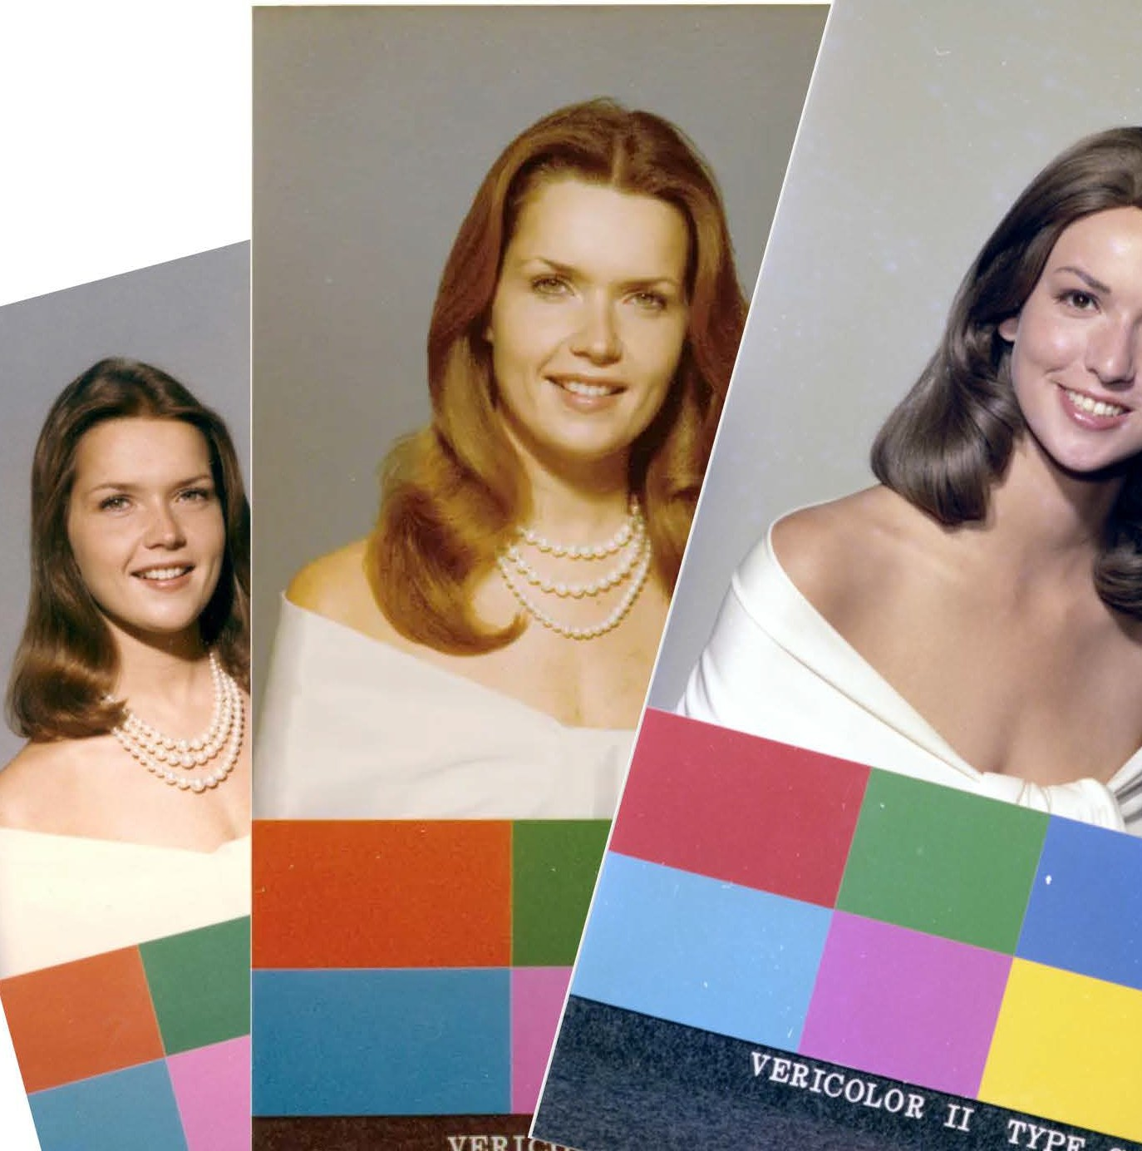

Slide 3
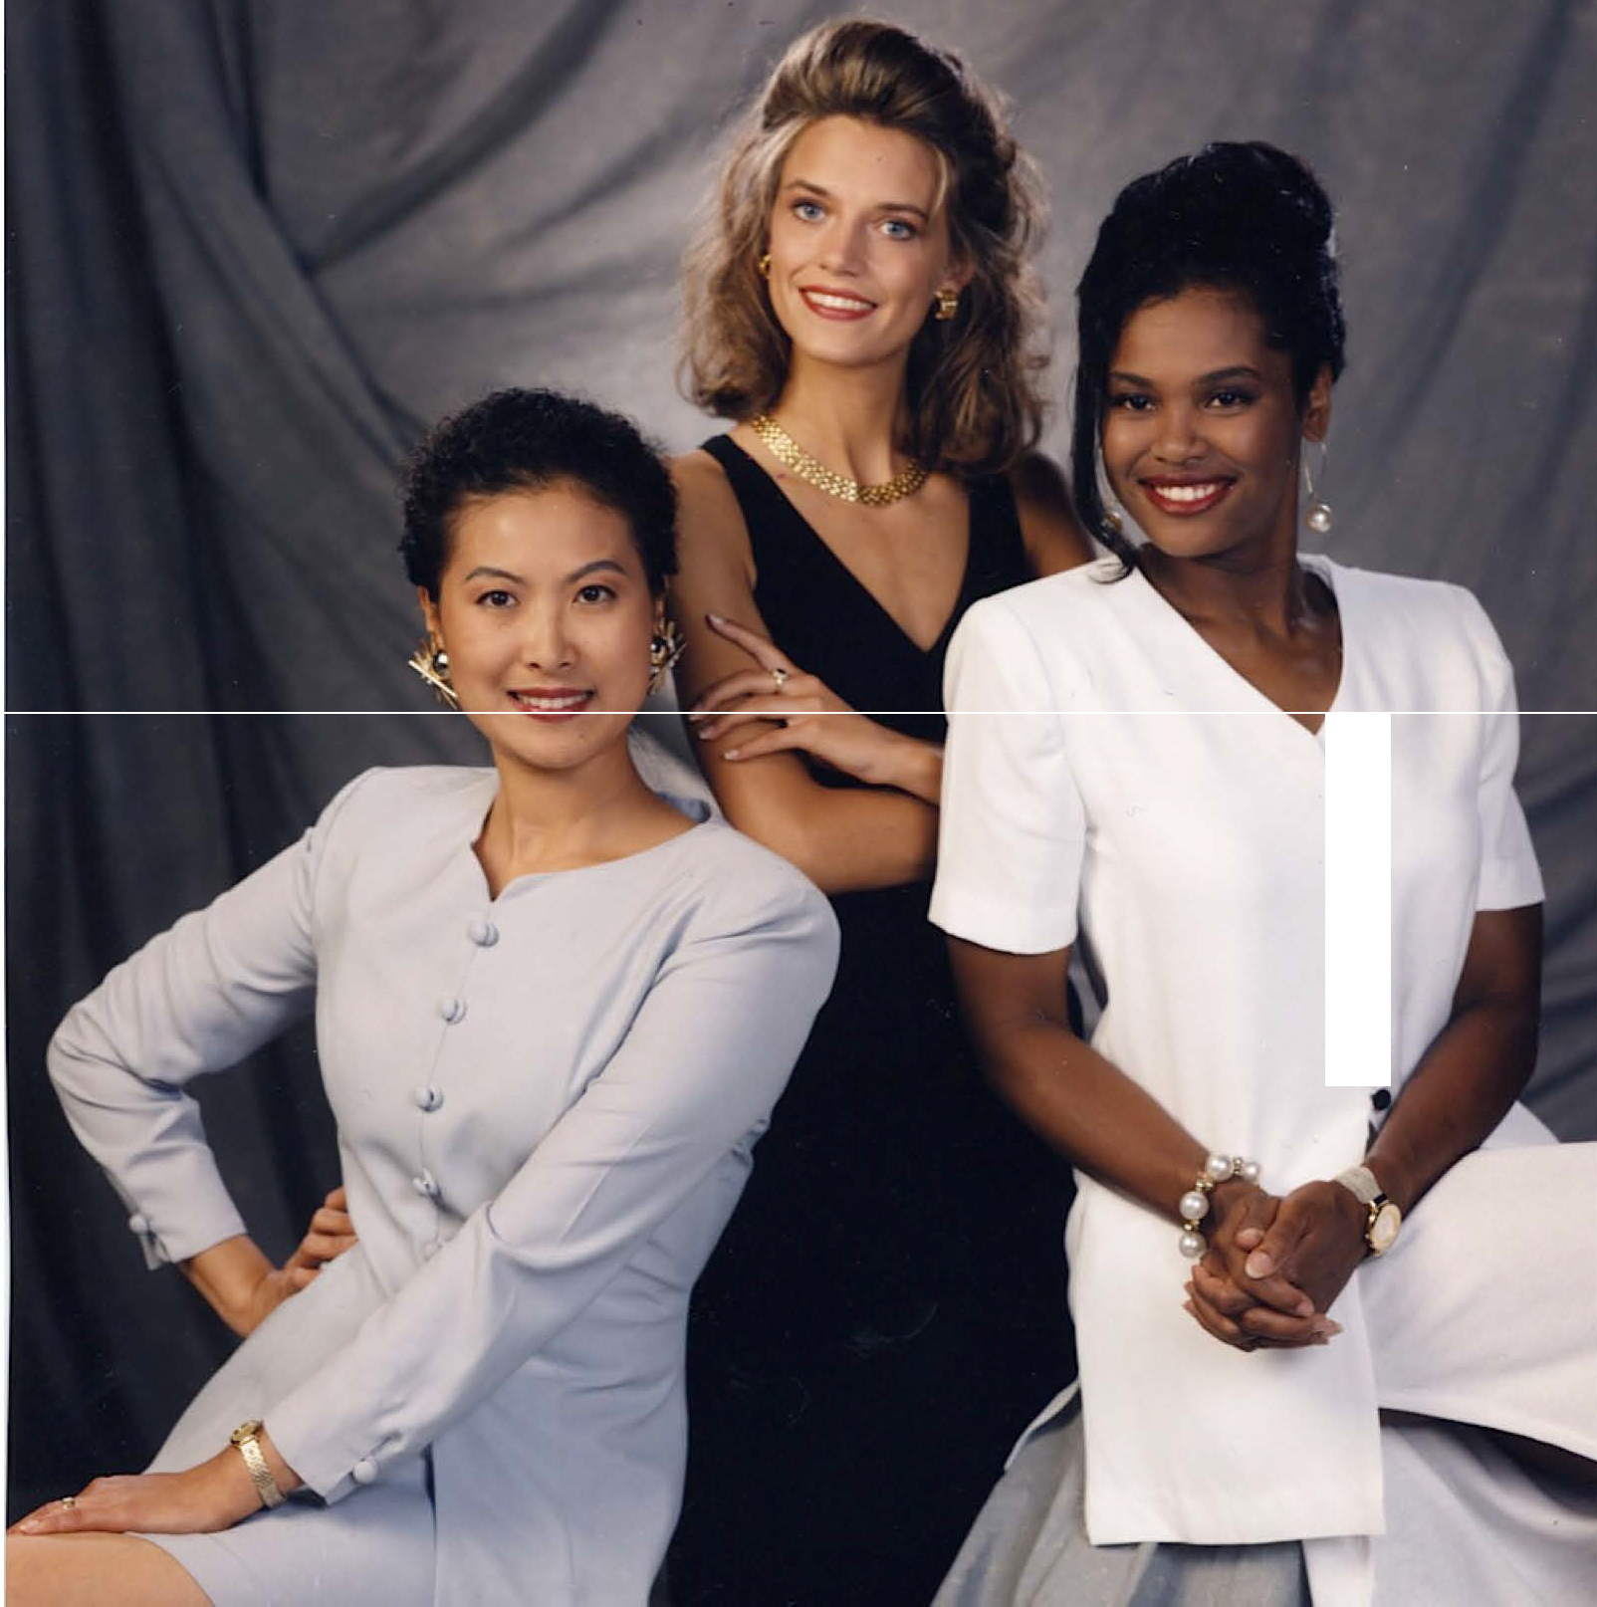
•
•
•
•
•
•

Slide 4




Old Standard: Color Code
(Technical & Conformitive)
New Standard: A Human (Organic & Unique)

Slide 5
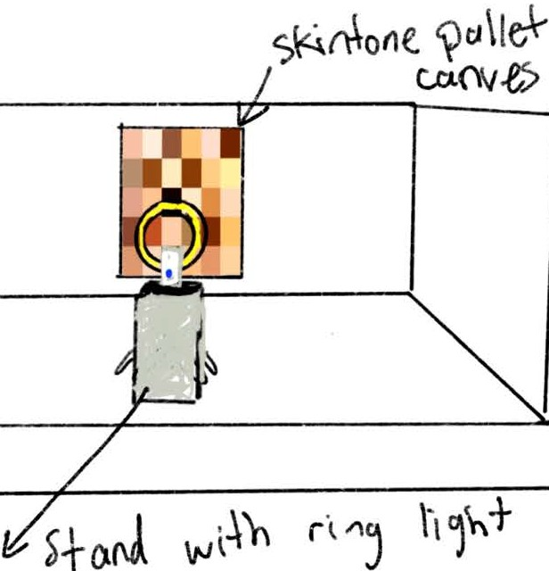
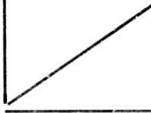
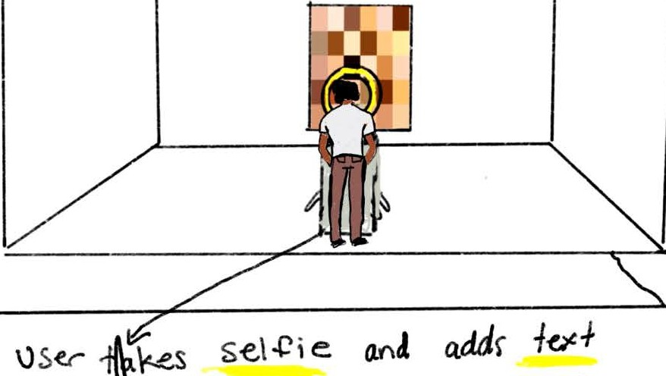
.,
f
•

Slide 6
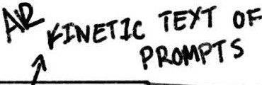

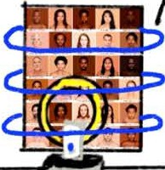
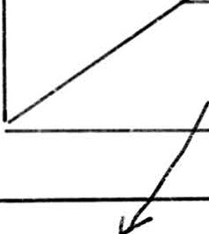



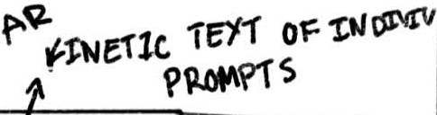






..,
..,
- .. -
,_

Slide 7





Slide 8


Slide 9


Slide 10
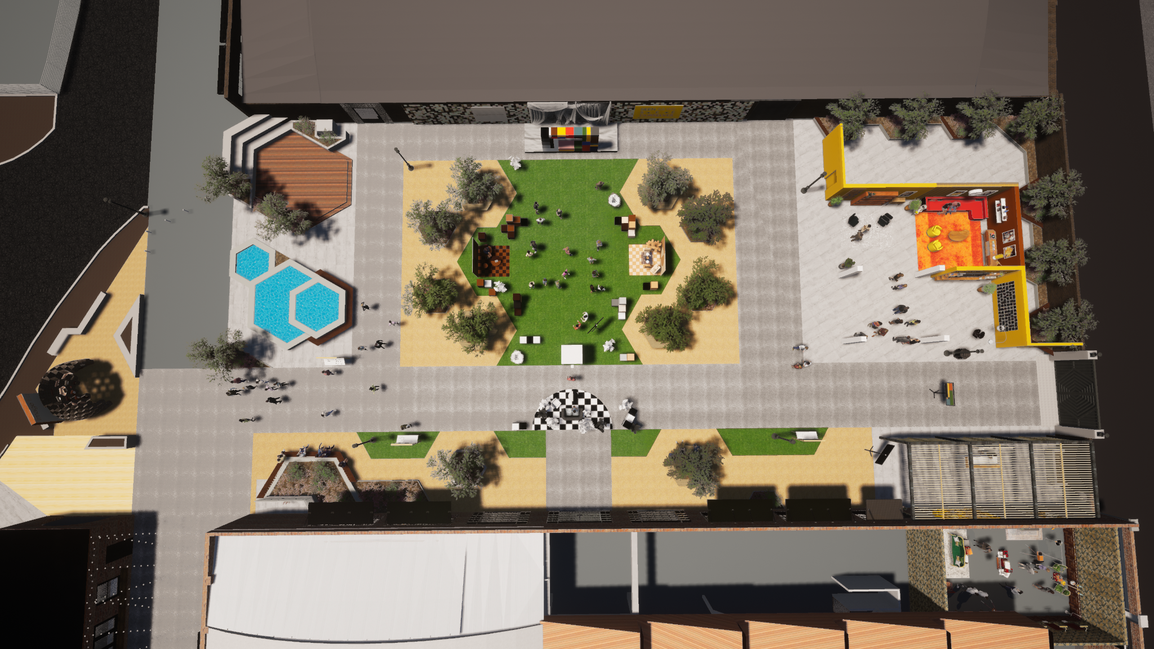
6
9
5
4
7
1
KEY:
1 - Valet Drop-off
2 - Check-in
3 - Seen in Power
4 - Seen in Color
5 - Seen in Focus
6 - Seen as You See Yourself
7 - Gifting
8 - Restrooms
9 - Valet Pick-up
2
8
3

Slide 11
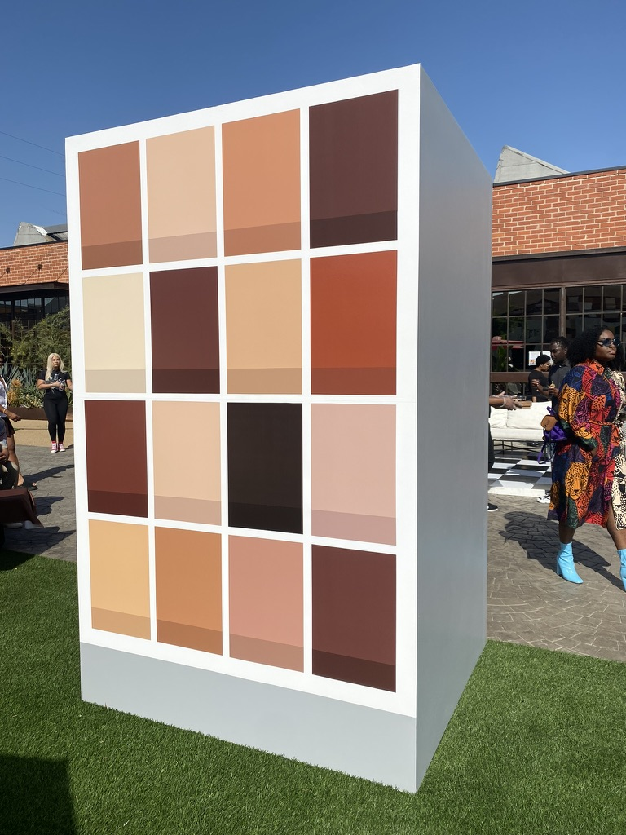
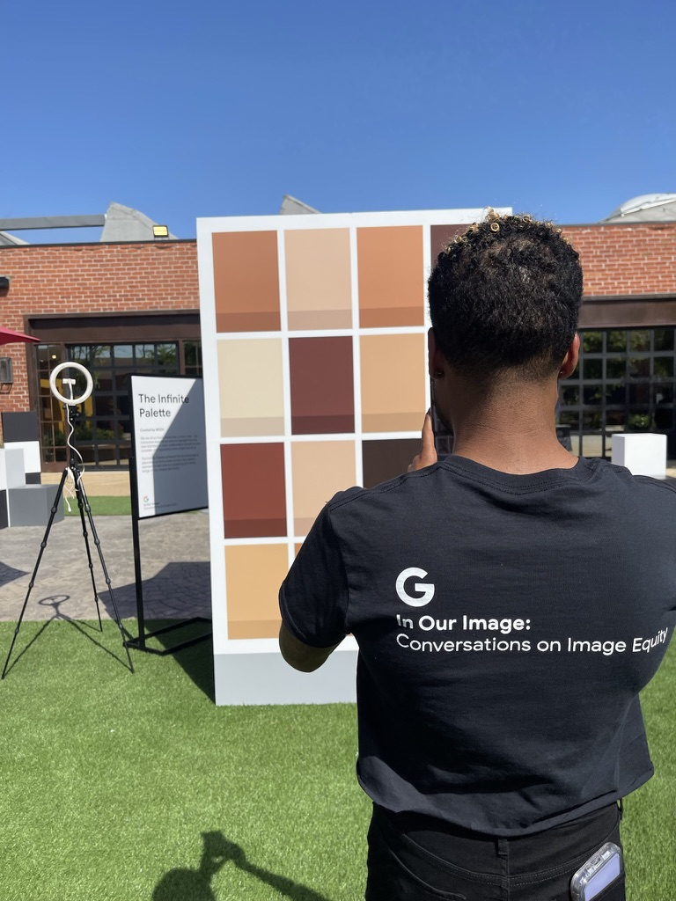
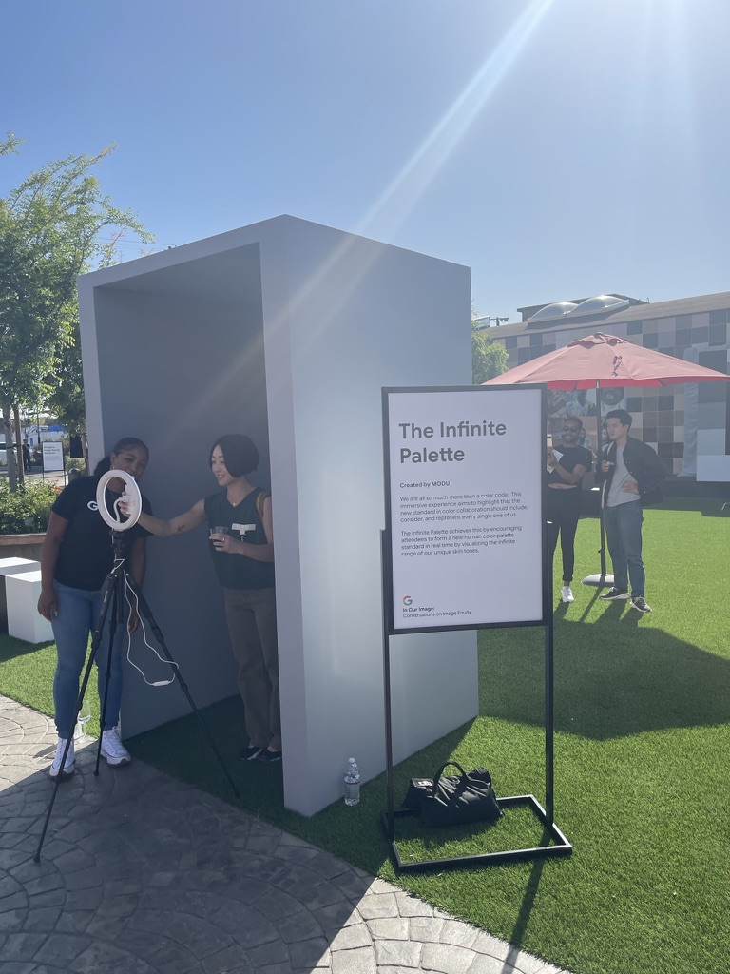

Slide 12
